Slide 1


Mahesh PREFAB PVT. LTD. (A UNIT OF Mahesh grc)
Manufacturers of GLASS FIBRE REINFORCED CONCRETE

Slide 2


Technical Collaboration
Mahesh Prefab is working in technical collaboration with 'Fiber Technologies International U.K.' to counter growing demand of GRC in construction industry.
MEMBER
MAHESH PREFAB IS AN ACTIVE MEMBER OF GLASS FIBRE REINFORCED CONCRETE ASSOCIATION.

Slide 3
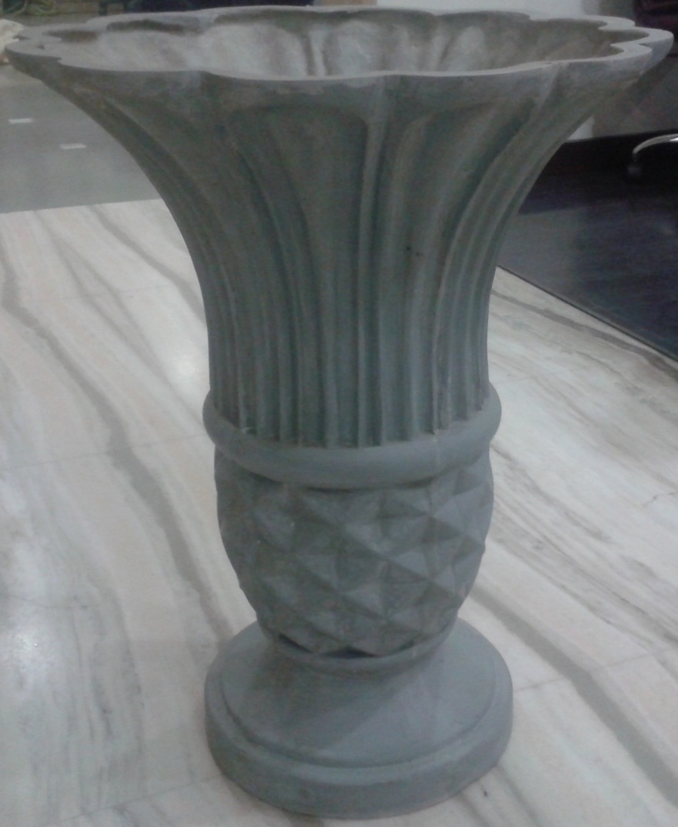
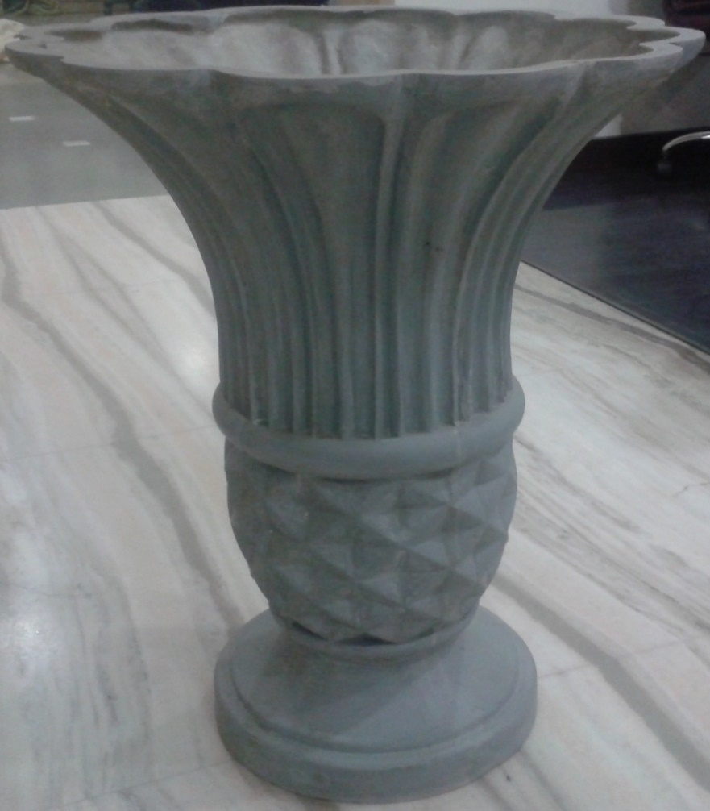
PLANTER NO. – 001
DIMENSIONS
INNER DIAMETER-21” OUTER DIAMETER-22”
HEIGHT-28”

Slide 4
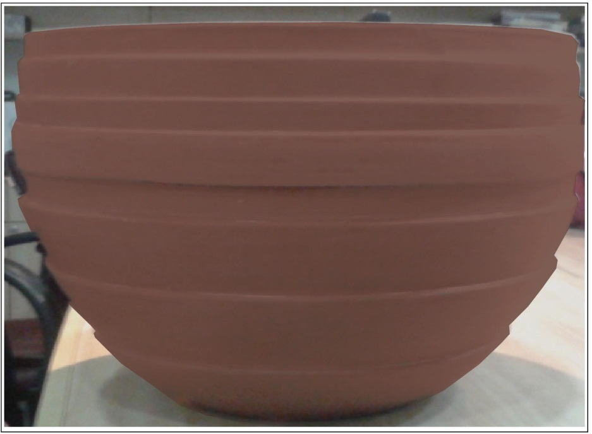
PLANTER NO. – 002
DIMENSIONS
DIAMETER-18”
HEIGHT-12”

Slide 5
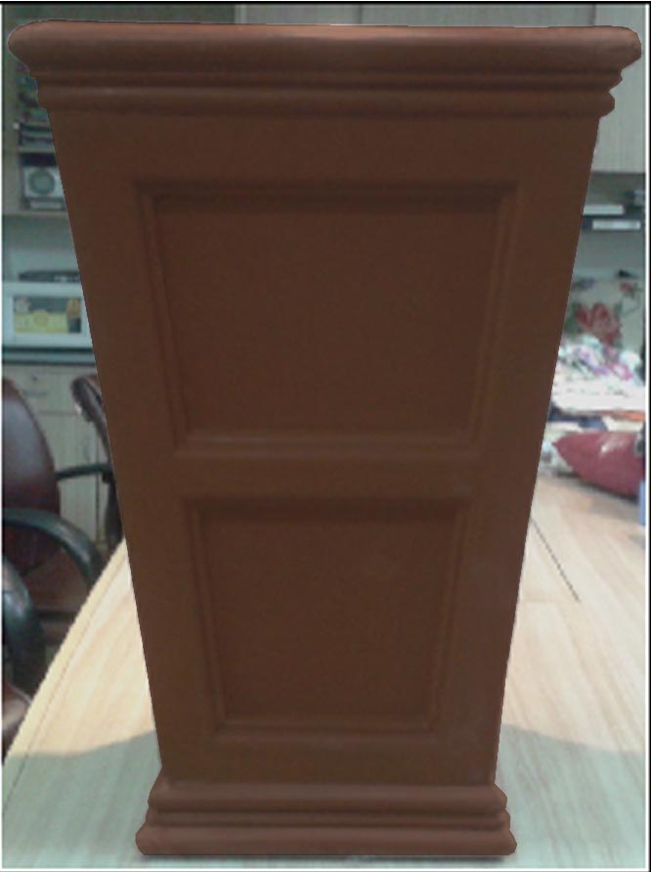
PLANTER NO. – 003
DIMENSIONS
INNER DIAMETER-14” OUTER DIAMETER-18”
HEIGHT-27”

Slide 6
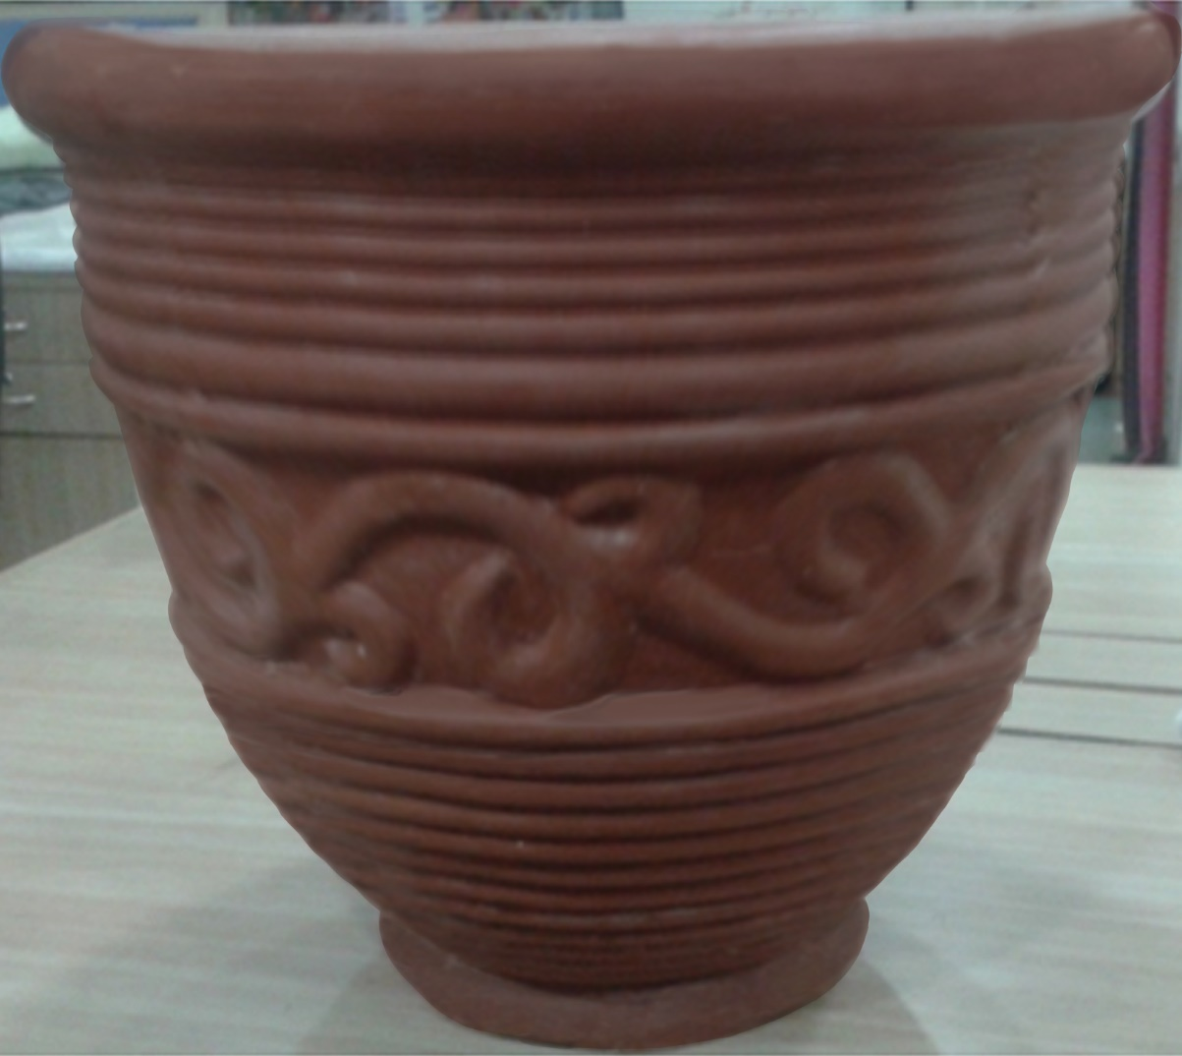
PLANTER NO. – 004
DIMENSIONS
INNER DIAMETER-15” OUTER DIAMETER-18”
HEIGHT-16”

Slide 7
PLANTER NO. – 005
DIMENSIONS NEW DIMENSIONS
INNER DIAMETER-10” INNER DIAMETER-14” OUTER DIAMETER-12” OUTER DIAMETER-16”
HEIGHT-15” HEIGHT-18”

Slide 8
PLANTER NO. – 006
DIMENSIONS NEW DIMENSIONS
INNER DIAMETER-10” INNER DIAMETER-14” OUTER DIAMETER-12” OUTER DIAMETER-16”
HEIGHT-10” HEIGHT-14”

Slide 9
PLANTER NO. - 007
DIMENSIONS NEW DIMENSIONS
INNER DIAMETER-4.5” INNER DIAMETER-12” OUTER DIAMETER-6.5” OUTER DIAMETER-14”
HEIGHT-12” HEIGHT-18”

Slide 10
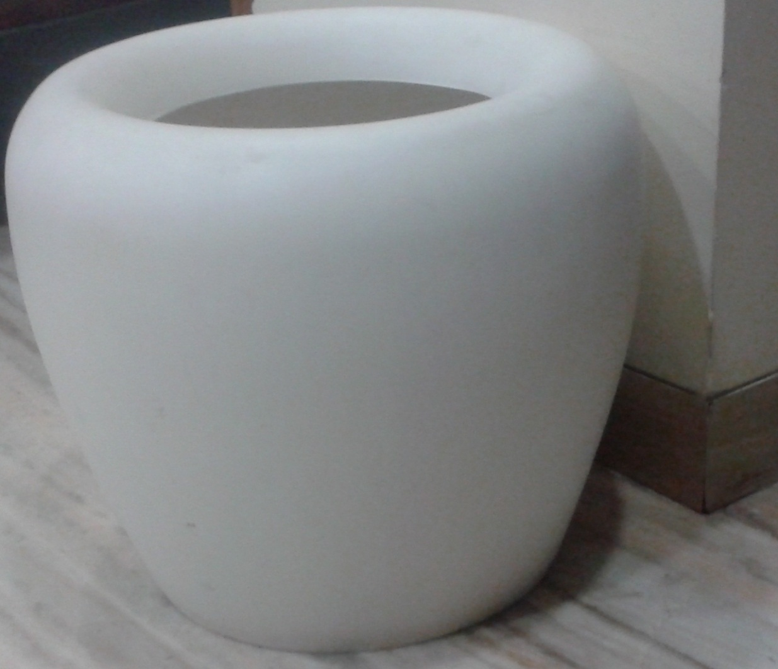
PLANTER NO. - 008
DIMENSIONS NEW DIMENSIONS
INNER DIAMETER-11” INNER DIAMETER-14” OUTER DIAMETER-15” OUTER DIAMETER-18”
HEIGHT-16” HEIGHT-20”

Slide 11
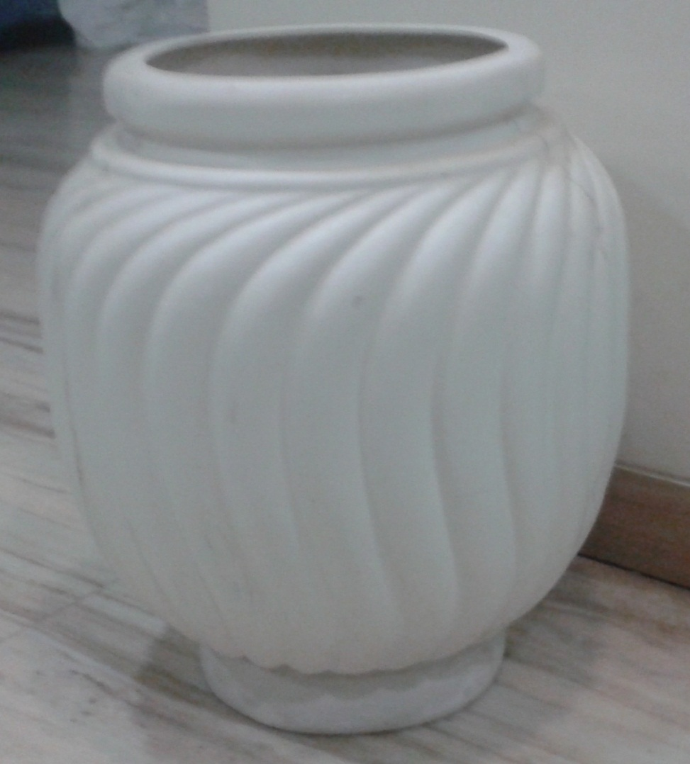
PLANTER NO. - 009
DIMENSIONS NEW DIMENSIONS
INNER DIAMETER-10.5” INNER DIAMETER-14” OUTER DIAMETER-12” OUTER DIAMETER-17”
HEIGHT-20” HEIGHT-20”

Slide 12
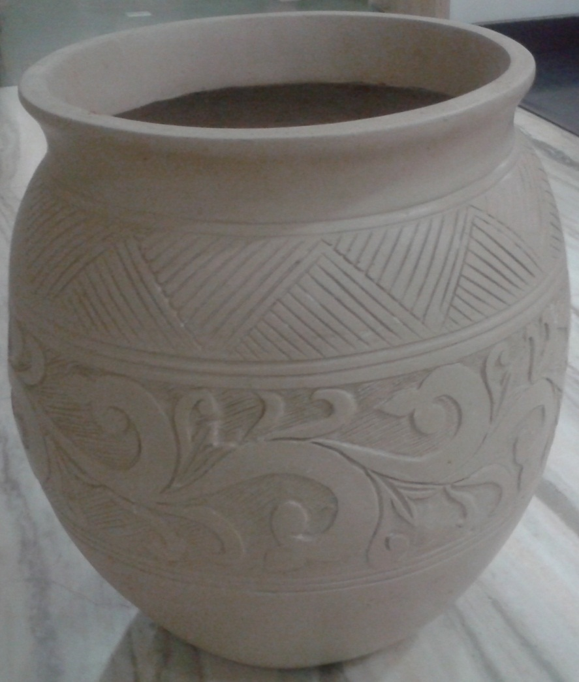
PLANTER NO. - 010
DIMENSIONS
INNER DIAMETER-13” OUTER DIAMETER-14”
HEIGHT-20”

Slide 13
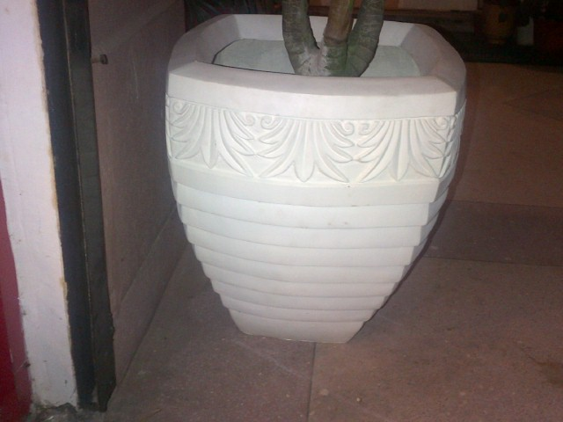
PLANTER NO. - 011
DIMENSIONS
INNER DIAMETER-18” OUTER DIAMETER-22”
HEIGHT-25”

Slide 14
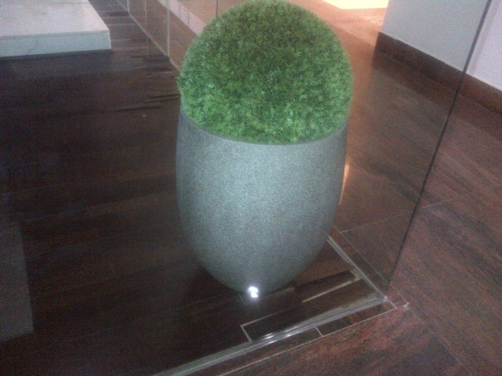
PLANTER NO. – 012
DIMENSIONS
INNER DIAMETER-22” OUTER DIAMETER-23”
HEIGHT-25”

Slide 15
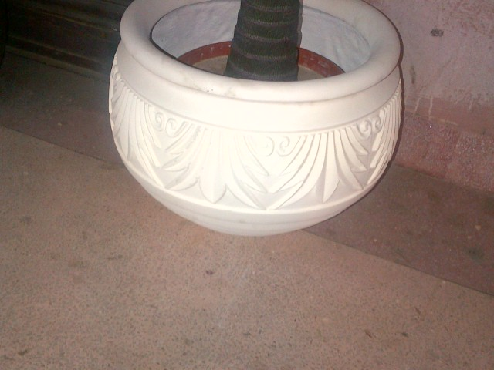
PLANTER NO. - 013
DIMENSIONS
INNER DIAMETER-14” OUTER DIAMETER-18”
HEIGHT-14”

Slide 16
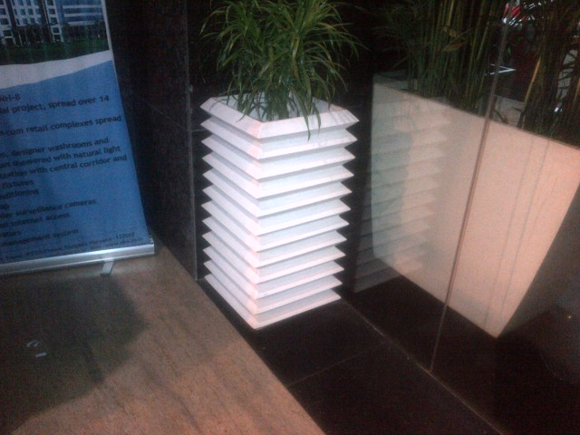
PLANTER NO. - 014
DIMENSIONS
WIDTH-15”
HEIGHT-30”

Slide 17
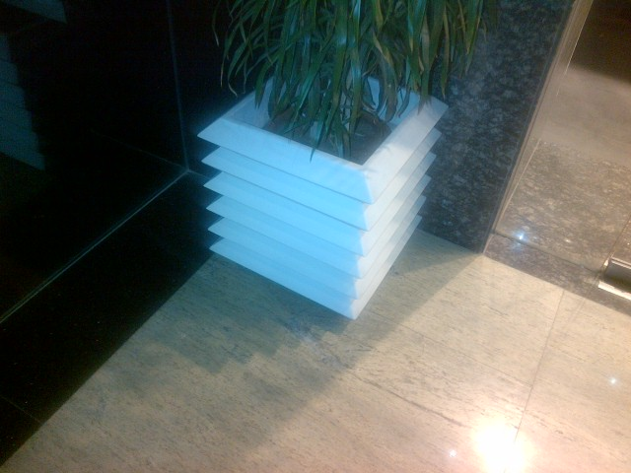
PLANTER NO. - 015
DIMENSIONS
WIDTH-15”
HEIGHT-15”

Slide 18
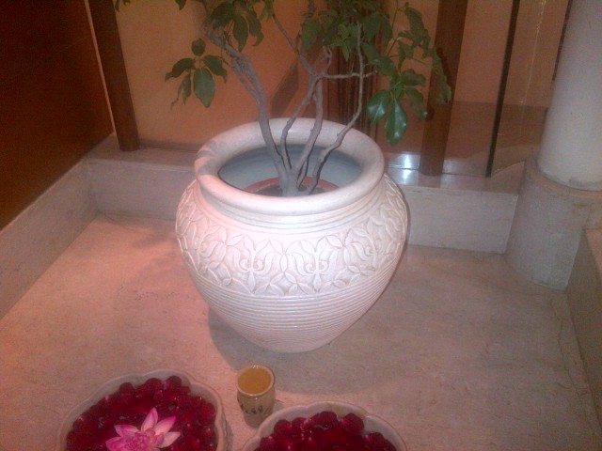
PLANTER NO. - 016
DIMENSIONS
INNER DIAMETER-12.5” OUTER DIAMETER-14.5”
HEIGHT-20”

Slide 19
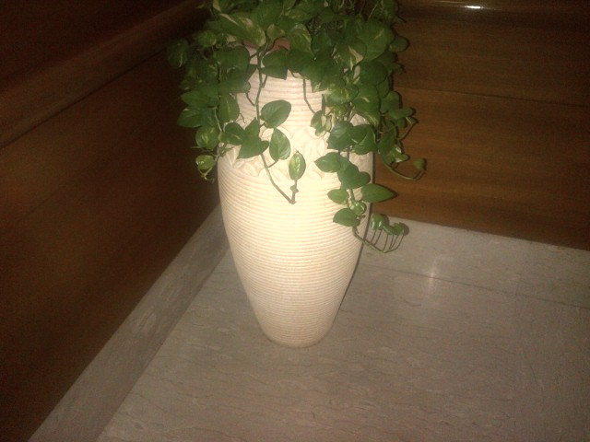
PLANTER NO. - 017
DIMENSIONS
INNER DIAMETER-16” OUTER DIAMETER-18”
HEIGHT-35”

Slide 20
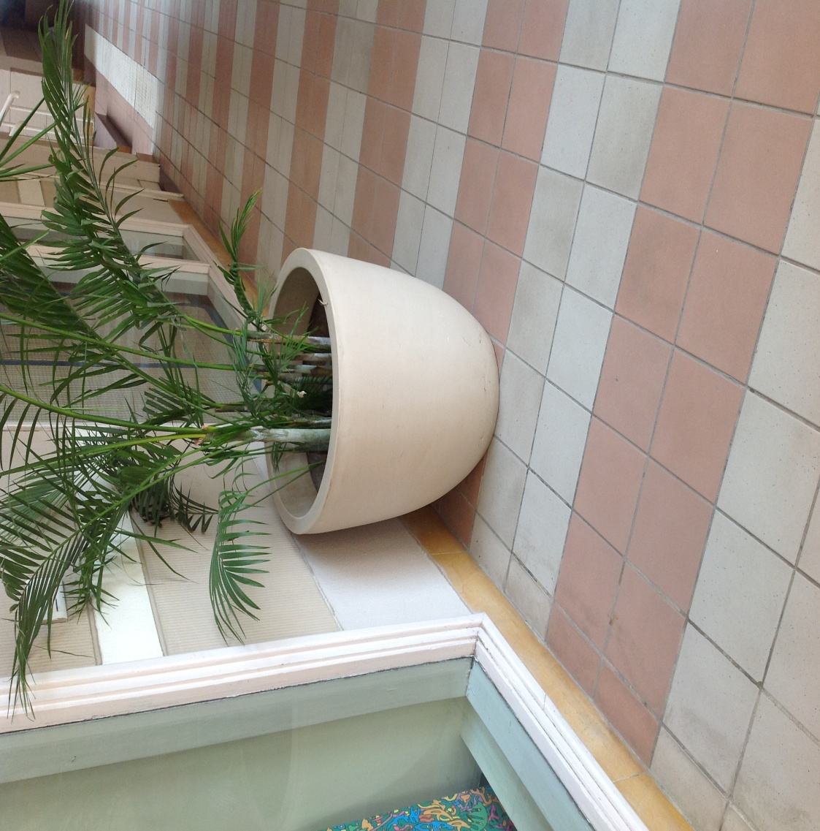
PLANTER NO. - 018
DIMENSIONS
INNER DIAMETER-15” OUTER DIAMETER-18”
HEIGHT-15”

Slide 21
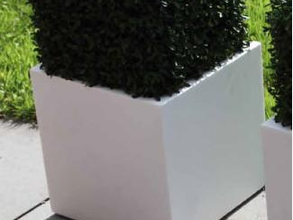
PLANTER NO. - 019
DIMENSIONS
INNER WIDTH-12 ” OUTER WIDTH-15”
HEIGHT-15”

Slide 22
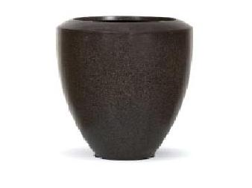
PLANTER NO. - 020
DIMENSIONS
INNER DIAMETER-14” OUTER DIAMETER-18”
HEIGHT-20”

Slide 23
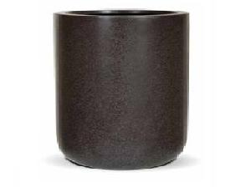
PLANTER NO. - 021
DIMENSIONS
INNER DIAMETER-22” OUTER DIAMETER-23”
HEIGHT-25”

Slide 24
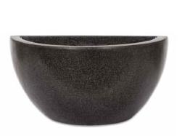
PLANTER NO. - 022
DIMENSIONS
INNER WIDTH-18” OUTER WIDTH-20”
HEIGHT-12”

Slide 25
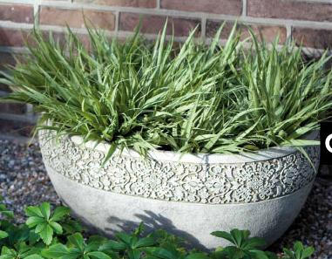
PLANTER NO. - 023
DIMENSIONS
INNER WIDTH-28” OUTER WIDTH-30”
HEIGHT-15”

Slide 26
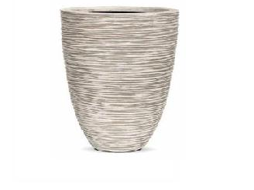
PLANTER NO. - 024
DIMENSIONS
INNER DIAMETER-22” OUTER DIAMETER-24”
HEIGHT-30”

Slide 27
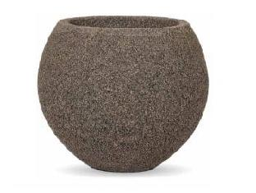
PLANTER NO. - 025
DIMENSIONS
INNER DIAMETER-12.5” OUTER DIAMETER-13.5”
HEIGHT-16”

Slide 28
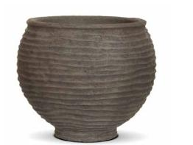
PLANTER NO. - 026
DIMENSIONS
INNER DIAMETER-14.5” OUTER DIAMETER-16.5”
HEIGHT-18”

Slide 29
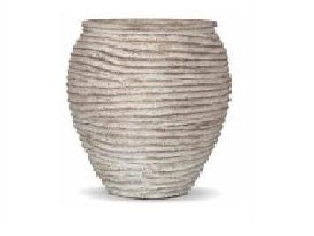
PLANTER NO. - 027
DIMENSIONS
INNER DIAMETER-13.5” OUTER DIAMETER-14.5”
HEIGHT-20”

Slide 30
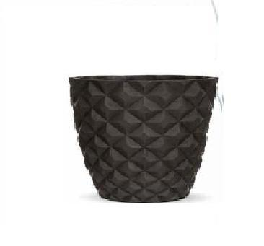
PLANTER NO. - 028
DIMENSIONS
INNER DIAMETER-17” OUTER DIAMETER-18”
HEIGHT-15”

